Slide 1
Learning in Activity 学习活动
Nemekhjargal. G

Slide 2
Content
Definition of Learning in Activity
Perspectives that Theorize Activity Systems
Framework for Analyzing System-Level Activity and Learning
Patterns of Explanation Involving Activity System-Level Phenomena and Concepts
Learning Concepts in Activity
Conclusion

Slide 3
Definition of Learning in Activity
Processing and Applying Information
Students are involved in activity to discover process and apply information
Motivating the students
Motivate students to solve problems in ways that are authentic during the activity
Stimulating thinking
Make students to consider and go through the facts and details

Slide 4
What is activity learning

Slide 5
Activity system can be…
As large as a classroom of students with a teacher
As small as a single, individual interacting with some text or a computer program

Slide 6
Perspectives that Theorize Activity Systems
cultural-historical activity theory (e.g., Engeström, 1987),
situated learning (Lave & Wenger, 1991),
situated action (Suchman, 1987),
distributed cognition (Hutchins & Klauson, 1998),
cultural psychology (Cole, 1996; Rogoff, 2003).

Slide 7
Learning in Activity
Community of practice-people who are sharing the same practices. When individuals want to join a community of practice, they do not know how to participate in these shared practice and become…
Peripheral members of the community, and their learning gradually leads them to be involved in the community’s practices (Lave & Wenger, 1991).

Slide 8
Common classroom atmosphere
IRE or IRF (Initiation, Response, Evaluation or Feedback).
The teacher takes the first turn, I, usually asking a question.
Then the teacher calls on a student who takes the second turn, R, giving an answer.
The teacher takes the third turn, evaluating the student’s answer, E,
Sometimes adding feedback or providing clarification or elaboration, F (Wells, 1993).

Slide 9
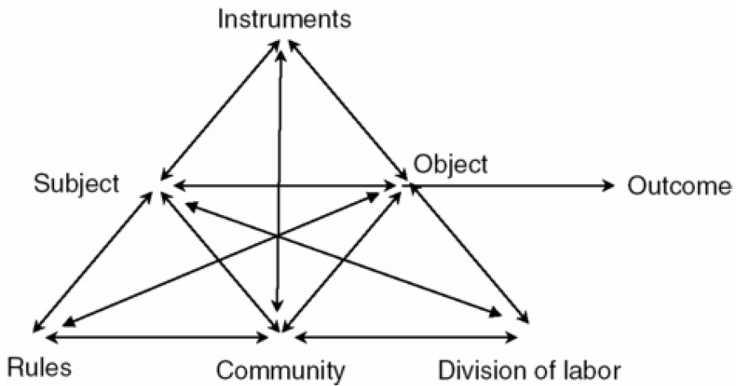
General Model of Activity System
Three major components of an activity system are:
Agent(an individual or a group)
Object or work to be done
Efforts which are used to perform(or instruments)

Slide 10
A Framework for Analyzing System-Level Activity and Learning
Marton distinguishes among three aspects of the learning object, namely the (a) instructor’s intended object of learning, (b) the enacted object of learning that “defines what it is possible to learn in the actual setting” (Marton & Tsui, 2004, p. 4), and (c) the eventual outcome as the student’s lived object of learning.

Slide 11
Marton and Tsui’s learning object three aspects

Slide 12
Not only teachers but also learners have intentions
Extended view of the learning object.

Slide 13
Patterns of Explanation Involving Activity System-Level Phenomena and Concepts
Three different forms of the process how learning happens are provided by the activity system. We can see these three different patterns in the next slides.

Slide 14
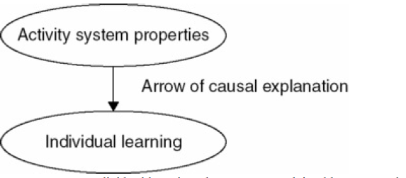
Pattern 1: Individual Learning Explained by System-Level Hypotheses
An individual participates in the activity and the improvement is noticed in the learner

Slide 15
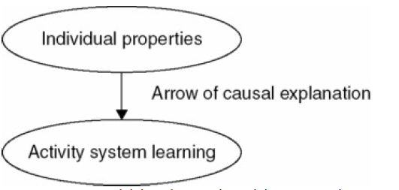
Pattern 2. Explaining Changes in Activity Systems in Terms of the Individual Participants in the System
Learning is explained in terms of mental representations and behaviors of the participating individuals

Slide 16
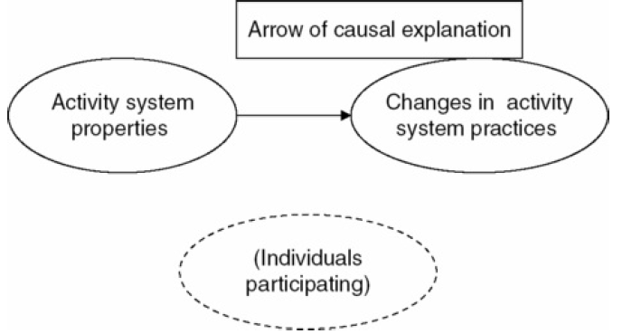
Pattern 3: Activity System-Level Phenomena Explained by Hypotheses of Activity System Properties
Cause and effect are both at the same level of analysis so this pattern has horizontal form

Slide 17
Learning Concepts in Activity
Experimental cognitive psychologists have mainly focus on learning concepts to studies of individuals in laboratories, engaged in the task of learning rules for classifying stimuli. In this section, settings of practice that are useful in conducting the community’s activities are emphasized

Slide 18
PD Ratio and Stabilization
Cussins’s key concepts are perspective dependence (PD) and stabilization.
Perspective dependence (PD) is close to zero, for example, when a person is completely unable to find his or her way to any desired location in the territory.
Stabilization is often achieved by naming, that is, imposing a linguistic structure on experience.

Slide 19
Generality as high PD ratio and high stabilization (Cussins, 1992, p. 683).
Demonstrates that
concepts emerge when the PD ratio is high and stabilization is high.

Slide 20
Conclusion
To sum up, activity system is facing new challenges and possibilities and further theoretical and methodological development or improvement are required.
Focusing on activity learning, three patterns of explanation are identified and conducting studies that bring together these three patterns will be quite tough question.
Finally, relationship between object and context and the ways of learning are mentioned here.

Slide 21
Thank you

